Slide 1

Types of Partnerships in Business
Introduction to Business Partnerships

Slide 2

Introduction to Business Partnerships
A business partnership is an agreement between two or more individuals to manage and operate a business together
Partnerships allow for shared resources, skills, and responsibilities
Different types of partnerships suit various business needs and goals

Slide 3
In the U.S., partnerships account for about 7% of all business. ​ They generate about 5% of all sales and about 10% of all income

Slide 4

Different Types of Partnerships

Slide 5

1. General Partnership (GP)
Definition: All partners share equal responsibility and liability
Key features:
Shared management and decision-making
Equal profit and loss distribution (unless agreed otherwise)
Unlimited personal liability for business debts
Split everything 50/50

Slide 6
2. Limited Partnership (LP)
Definition: a business owned by two or more parties, with at least one being the general partner who oversees the business, and one or more thare are limited partners
Key features:
General partners manage the business and have unlimited liability
Limited partners invest money but have no part in management
The Limited partners' liability is restricted to their investment (personal property is protected)
Also Called a Silent Partner
Basically done to gain more capital through investments

Slide 7
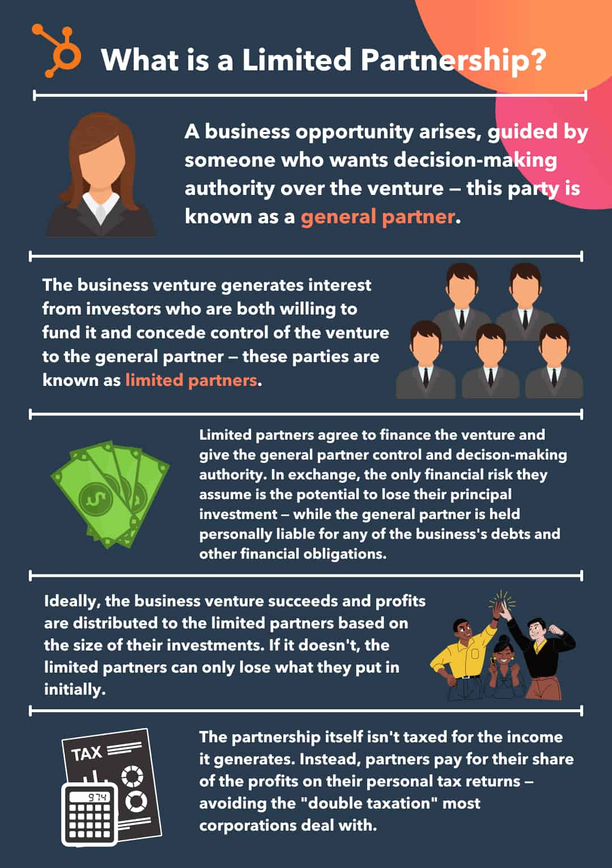

Slide 8
3. Limited Liability Partnership (LLP)
Definition: Partners work together, they separately manage their customers or clients, and have limited personal liability for business debts
Key features:
Often used by professional services (e.g., law firms, accounting firms)
Protects partners from debts caused by other partners' negligence
Each partner is liable for their own actions
Each partner’s liabilities are limited to the amount they put into the business.

Slide 9
4. Joint Venture
Definition: Temporary partnership for a specific project or goal
Key features:
Limited duration and scope
Partners maintain separate business identities
Shared resources, risks, and rewards for the specific venture

Slide 10

Partnership Agreement
Partnership Agreement: a contract stating the terms of a partnership – what it does, how it works, and how the partners can work together.
Why Needed:
It is a legally binding document that specifies the terms and conditions of a collaboration between two or more individuals or entities.
Its purpose is to define each partner's rights and responsibilities, including their obligations, roles, and how profits are shared.

Slide 11
Partnership Agreement
The rights and responsibilities of the partners are a vital component.
Document outlining:
Roles and responsibilities of partners
Profit and loss distribution
Decision-making processes
Dispute resolution procedures
Exit strategies

Slide 12
Real-World Examples
General Partnership: Local mom-and-pop store
Limited Partnership: Real estate investment groups
LLP: Law firms, accounting firms
Joint Venture: Movie production collaborations

Slide 13
Conclusion
Partnerships offer various structures for business collaboration
Each type has unique features, advantages, and disadvantages
Choosing the right partnership depends on business needs and goals
Proper planning and agreements are crucial for successful partnerships

Slide 14

Complete the Partnership Agreement Assignment:
Use the Handout to plan and daft your agreement. Follow the instructions in the handout
Use Google Docs to write your agreement. Share with your partners and each can write different sections
Hand in the Partnership Agreement into Google Classroom

